Slide 1




WEB SCRAPING AND EXPLORATORY DATA ANALYSIS OF FLIPKART MOBILE LISTINGS
Presented by: M. Sai Ajay Gowdu
From Data Collection to Market Insights

Slide 2


Project Overview
A
This project focuses on collecting smartphone listing data from Flipkart using web scraping techniques(Beautiful soup & Requests modules)
C
Exploratory Data Analysis (EDA) was performed to study product availability, pricing patterns, and brand-level trends
D
Brand-specific analysis was conducted with a deeper focus on Apple iPhone models.
B
The scraped data was cleaned and transformed into an analysis-ready dataset
E
The analysis aims to understand market positioning and product patterns without using sales data

Slide 3


Problem Statement
Online e-commerce platforms list a large number of smartphone models with varying prices, specifications, and availability statuses. However, without structured analysis, it is difficult to understand brand positioning, pricing patterns, and product availability trends. This project aims to analyze smartphone listings on Flipkart using web scraping and exploratory data analysis to uncover meaningful insights in the absence of sales data.

Slide 4


Objectives
To scrape smartphone listing data from Flipkart and create a structured dataset
To analyze product availability status across brands
To examine the relationship between product availability status and pricing across smartphone brands
To perform a focused analysis on Apple iPhone model listings
To explore relationships between price and key specifications using correlation analysis

Slide 5
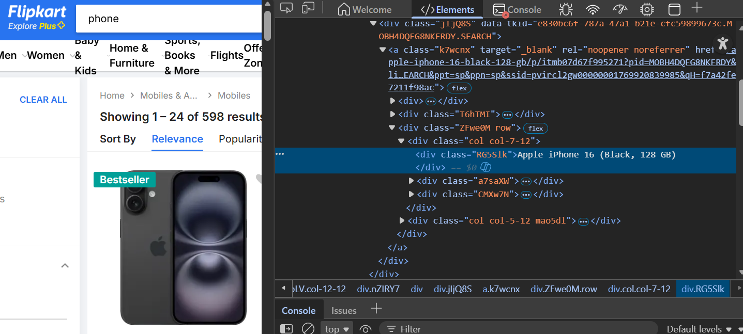
Data Source & Web Scraping Overview
🌐 Data Source
Platform: Flipkart (publicly available smartphone listings)
Data Type: Mobile phone product listings
Access Method: Web pages accessed through HTTP requests
Ethical Consideration: Only publicly visible data was collected
🕷️ Web Scraping Process
Used Requests and BeautifulSoup to extract smartphone listing data from Flipkart
Collected product details including price, availability, brand, model, and specifications
Stored the scraped data in a Pandas DataFrame for cleaning and analysis

Slide 6
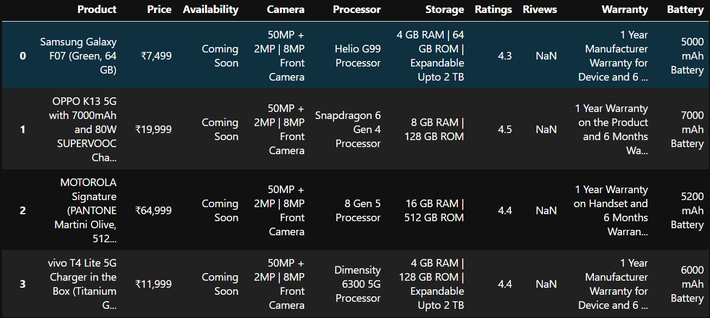
📊 Dataset Description
Includes Product, Price, Availability, Camera, and key technical specifications
Contains listings across multiple smartphone brands

Slide 7

Data Cleaning & Preparation
🧹🧹🧹🧹🧹🧹🧹🧹🧹🧹🧹🧹
Split raw product details into structured columns such as brand & Model
Also split raw column like camera and storage into front camera , back camera & RAM , ROM
Extracted numerical values from text-based fields using regular expressions (regex)
Converted extracted values into appropriate numerical data types for analysis
Prepared a clean, analysis-ready dataset for exploratory data analysis

Slide 8
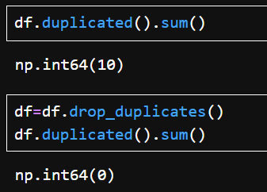
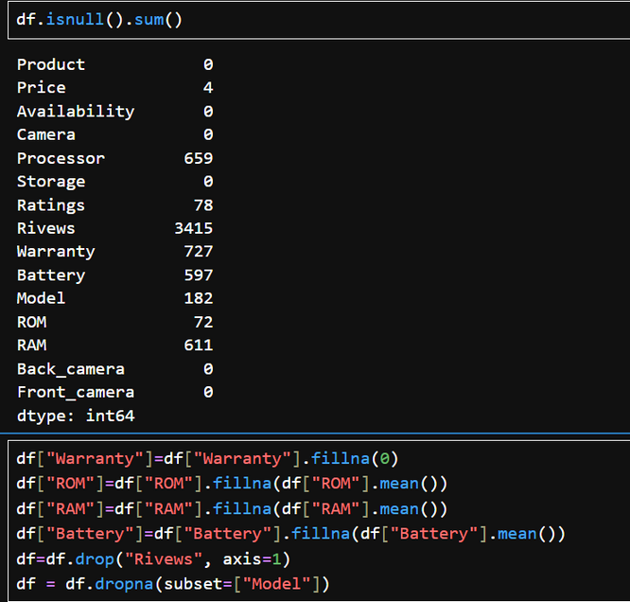
Natural products
🔹 Missing Value Handling
Removed columns with excessive missing values that did not contribute to analysis
Applied mean imputation for selected numerical features where appropriate
Dropped rows with missing values in key identifier columns such as model name
Handled brand-specific missing patterns (e.g., battery information for iPhone listings) carefully to avoid introducing assumptions

Slide 9
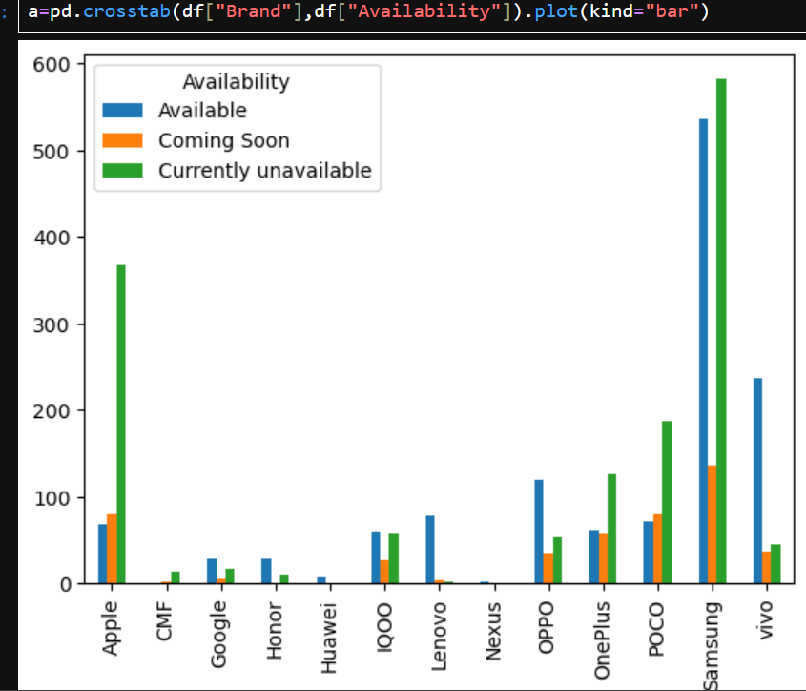

📊
This bar chart compares how many phone listings each brand has under:
Available
Coming Soon
Currently Unavailable
Most brands show a higher number of currently unavailable listings compared to available ones
Apple and Samsung have a significantly large number of unavailable listings, indicating frequent model turnover or discontinued listings
Budget and mid-range brands generally have fewer “coming soon” listings
Availability patterns vary noticeably across brands, reflecting different product lifecycle strategies

Slide 10
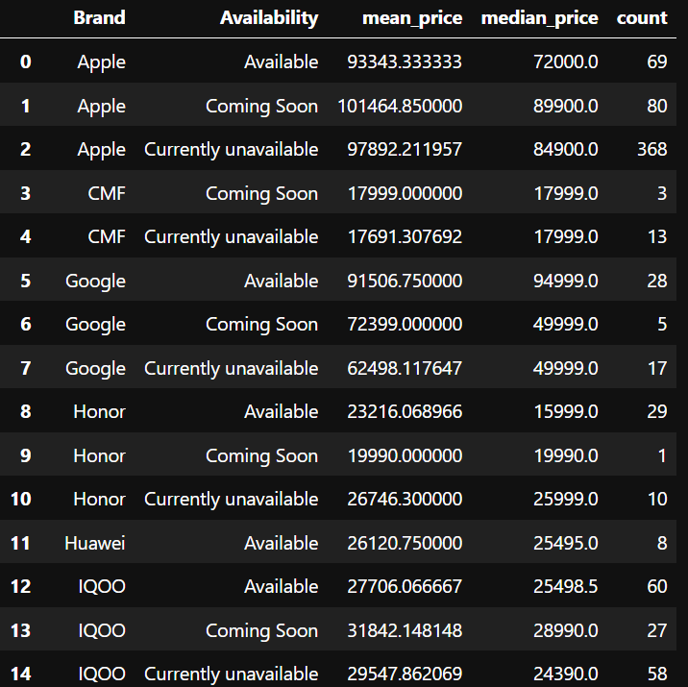
🔹 Insight 1: “Coming Soon” phones are usually priced higher
Example:
Apple Available → ~₹93k Coming Soon → ~₹1.01L (highest)
IQOO
Available → ~₹27.7k Coming Soon → ~₹31.8k
👉 Interpretation:
Upcoming models tend to be listed at higher prices, indicating launch-phase or premium positioning
🔹 Insight 2: “Currently unavailable” phones are often older models
Example:
Google Available → ~₹91.5k
Unavailable → ~₹62.5k
👉 Interpretation:
Lower prices for unavailable listings suggest older or discontinued models with reduced pricing.

Slide 11
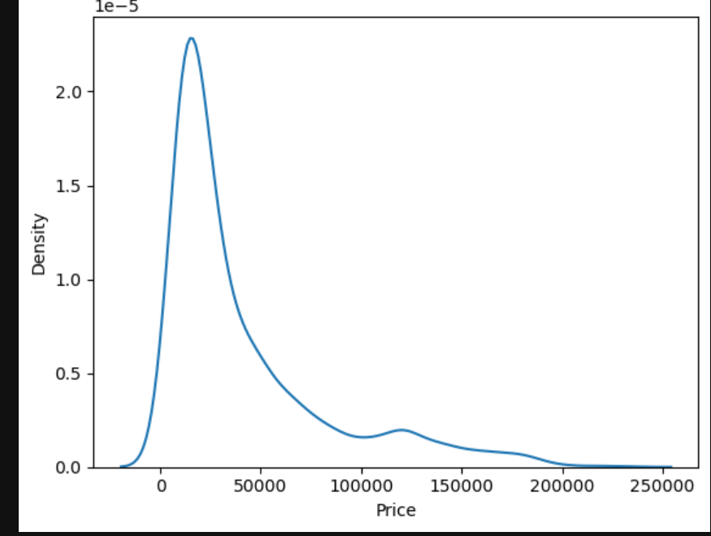
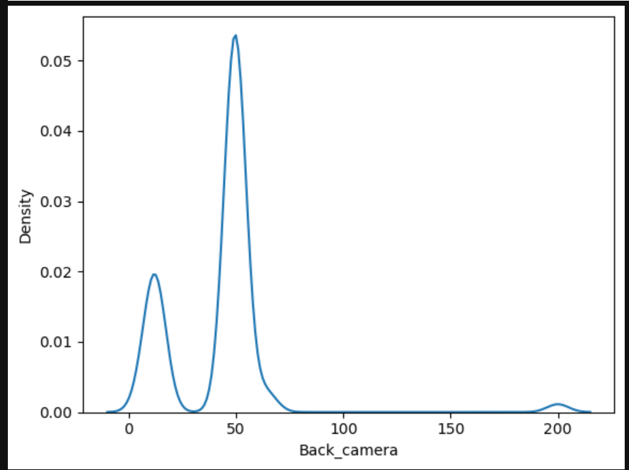
🔹 KDE Distribution Analysis
The price distribution is right-skewed, indicating a higher concentration of budget and mid-range smartphones with a smaller number of high-priced premium models.
The camera specification distribution is multimodal, revealing clear segmentation across budget, mid-range, and premium devices, with mid-range specifications being the most prevalent.

Slide 12
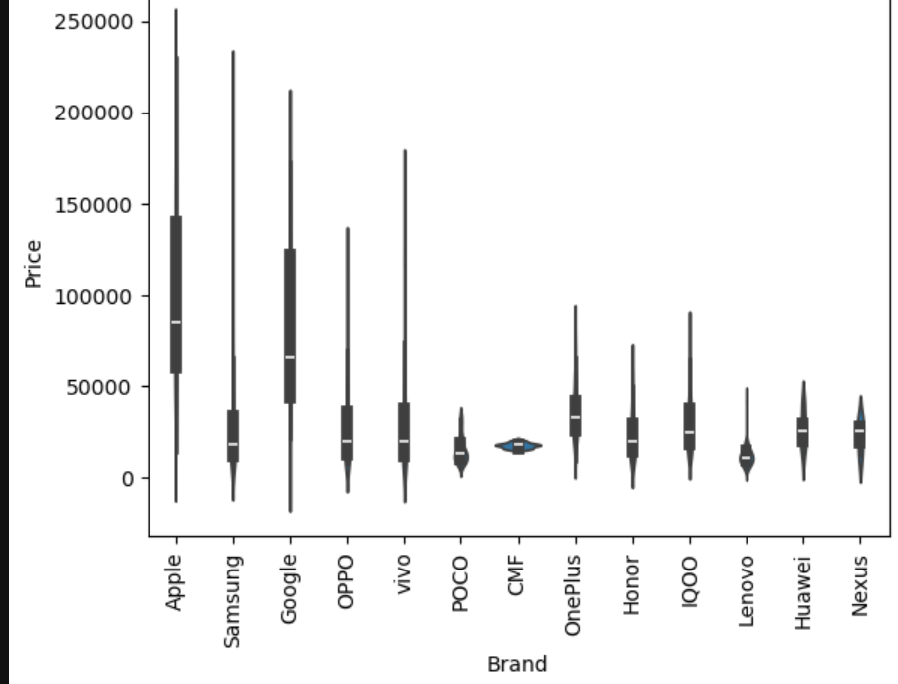
Insight 1: Brand price stability vs volatility
Apple, Samsung, Google → wide violins
→ Large price range, multiple segments (budget → premium)
CMF, POCO → narrow violins
→ Focused pricing, limited range
👉 This reveals pricing strategy consistency, not just price level.
🔹 Insight 2: Multi-segment vs single-segment brands
Wide + multiple bulges = multi-segment brands
Narrow + single bulge = single-segment brands
This is a strategy insight, not shown elsewhere.
🔹 Insight 3: Presence of outliers
Premium brands show high-price outliers
Budget brands rarely have extreme outliers

Slide 13
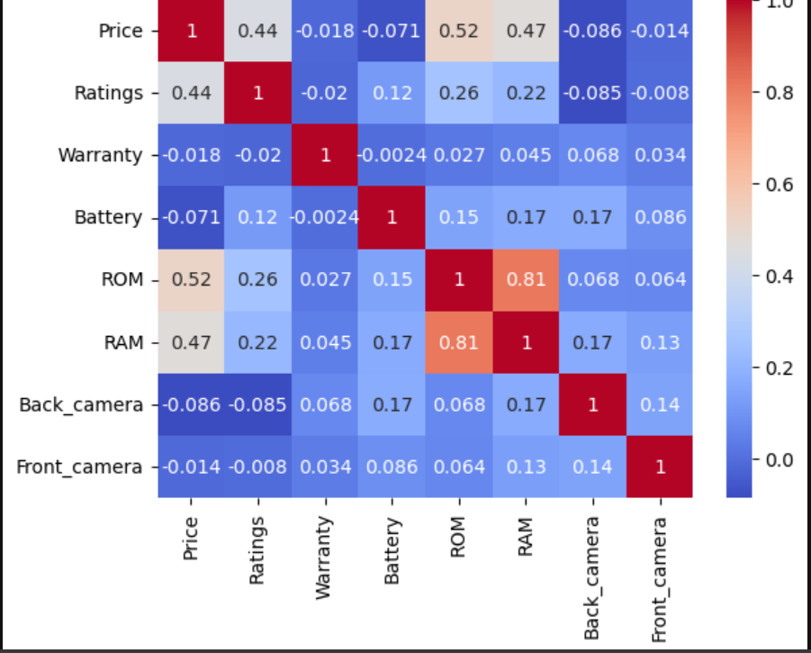
Price has a moderate positive correlation with ROM (0.52) and RAM (0.47), indicating that storage and performance are important pricing factors.
RAM and ROM are strongly correlated (0.81), showing that higher storage variants are usually paired with higher RAM.
Camera specifications (front and back) show weak correlation with price, suggesting megapixels alone do not drive pricing.
Battery, warranty, and ratings have minimal correlation with price, indicating limited influence on listed prices.

Slide 14
Conclusion & Key Takeaways
Smartphone listings on Flipkart show clear availability-based lifecycle patterns, with many models becoming unavailable over time
Pricing varies by availability status, with “Coming Soon” models generally positioned at higher prices
Premium brands operate across multiple price segments, while budget brands maintain more stable and narrow pricing ranges
Feature-based analysis shows that RAM and ROM have stronger associations with price than camera specifications
Distribution analysis reveals distinct budget, mid-range, and premium segments, particularly evident in camera specifications

Slide 15
Challenges & Learnings
Faced challenges during web scraping due to multiple camera specifications being captured for a single product, leading to data quality issues
Implemented conditional logic to ensure only one relevant camera specification was associated with each product
Gained hands-on experience in handling unstructured web data and improving data quality through preprocessing
Developed a deeper understanding of end-to-end data analysis, from data collection to insight generation

Slide 16

THANK YOU
The Q&A session begins

